Slide 1
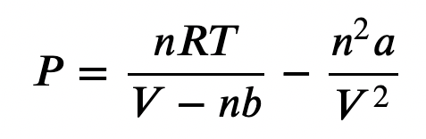
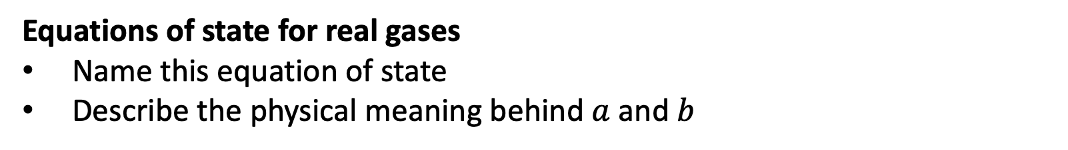
Week 1
Equations of state for real gases
Name this equation of state
Describe the physical meaning behind $a$ and $b$

Slide 2
Week 1
E-format convention for scientific notation
Write 1.38 x 10⁻²³ using the E-format convention

Slide 3
Week 1
Common pressure units
Rank these in order of the biggest unit to the smallest unit (like, 1 hour > 1 minute):
atm, bar, pascal, torr

Slide 4
Week 1
Unit conversions with Pint
What will print at the end of each code sequence? 1 atm = 1.013 bar.
# Code sequence 1
P = AssignQuantity(1, “atm”)
P.to(”bar")
print(P)
# Code sequence 2
P = AssignQuantity(1, ”atm”)
P.ito(”bar")
print(P)

Slide 5
Week 2
Isochores and isotherms
Which set of points is an isochore? Which is an isotherm?
T, V state space
V
T

Slide 6
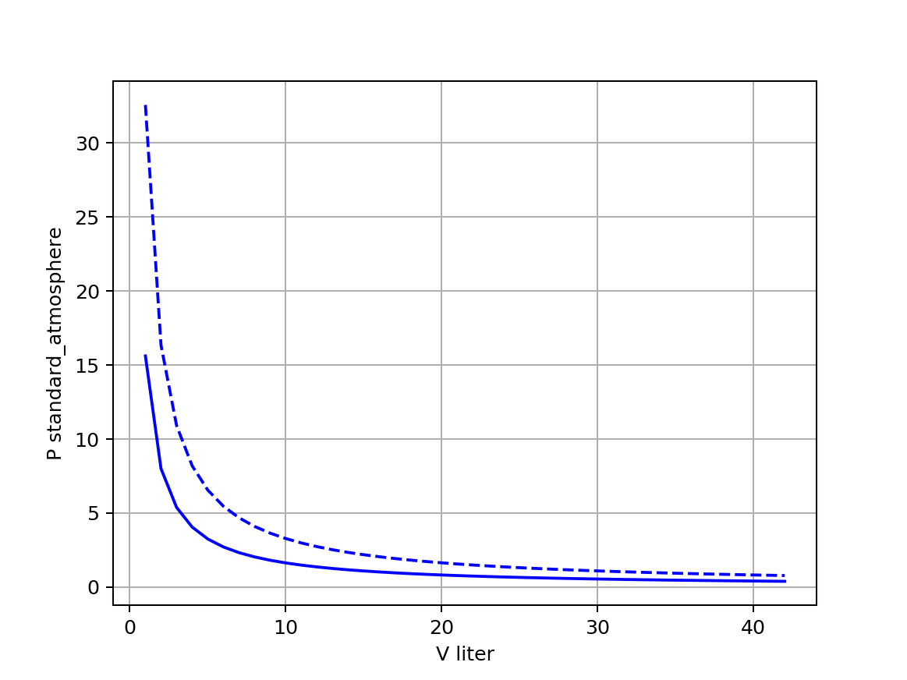
Week 2
Boyle isotherms
Which line is the hotter isotherm? What’s your reasoning?

Slide 7
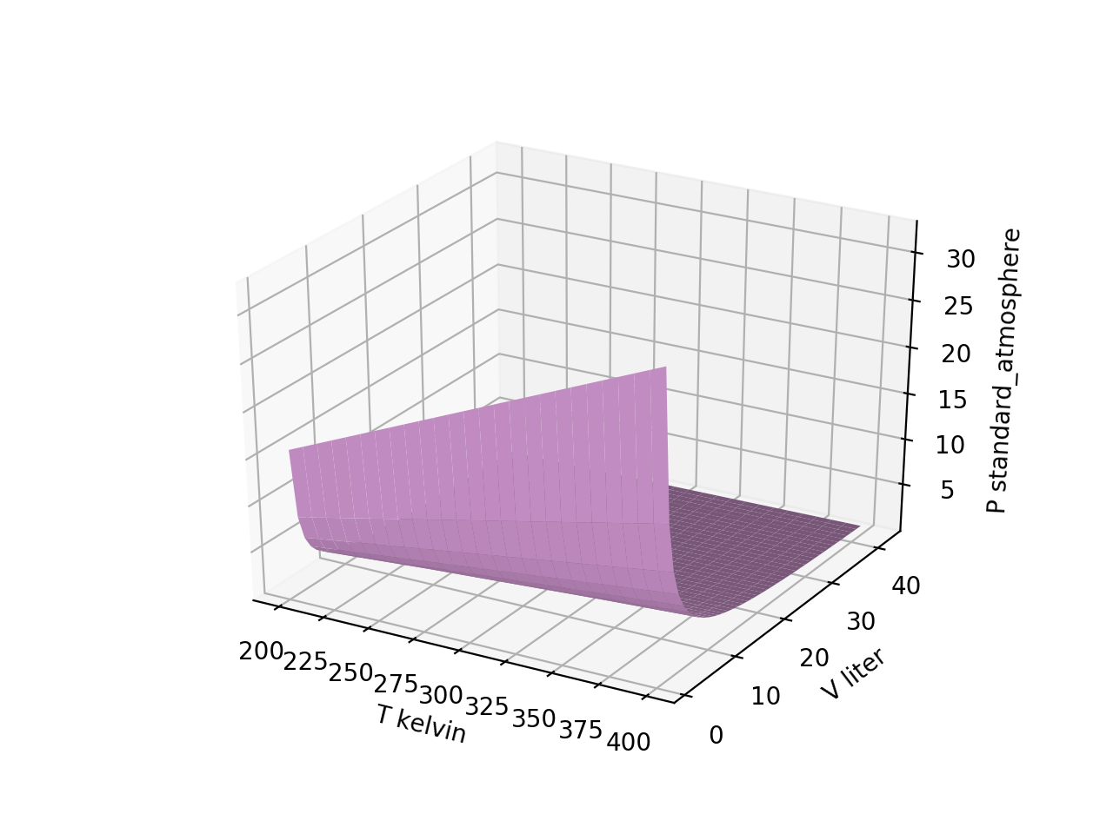
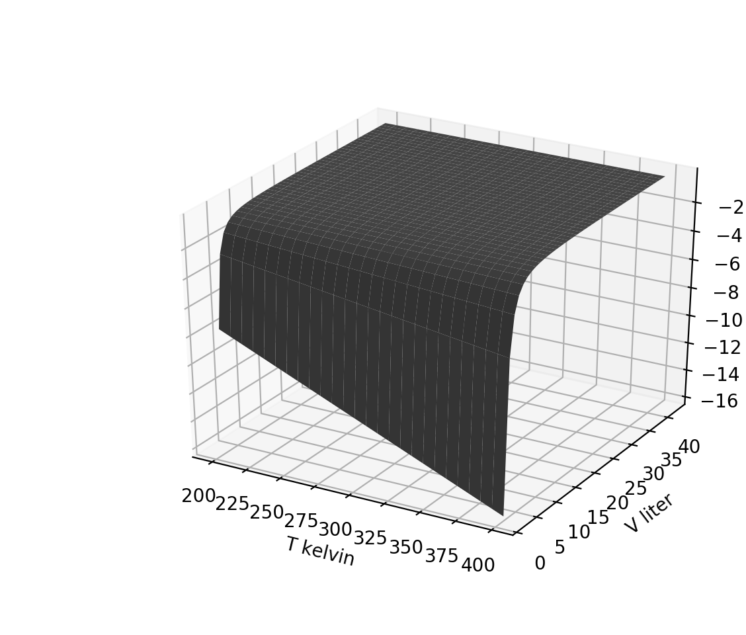

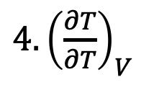
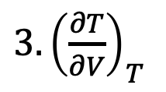
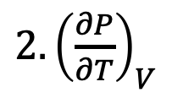
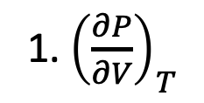
Week 2
Visualizing derivative thermodynamic surfaces
Which thermodynamic surface is the one on the right?
1. ${\left(\frac{∂P}{∂V}\right)}_{T}$
$$P(T,V)$$
$2. {\left(\frac{∂P}{∂T}\right)}_{V}$
${3. \left(\frac{∂T}{∂V}\right)}_{T}$
${4. \left(\frac{∂T}{∂T}\right)}_{V}$

Slide 8

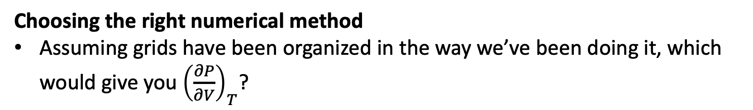
Week 2
Choosing the right numerical method
Assuming grids have been organized in the way we’ve been doing it, which would give you ${\left(\frac{∂P}{∂V}\right)}_{T}$?
${\left(\frac{∂P}{∂V}\right)}_{T}$
$$P(T,V)$$
dF_dx([Tgrid,Vgrid],Pgrid)
dF_dy([Tgrid,Vgrid],Pgrid)
dF_dz([Tgrid,Vgrid],Pgrid)

Slide 9
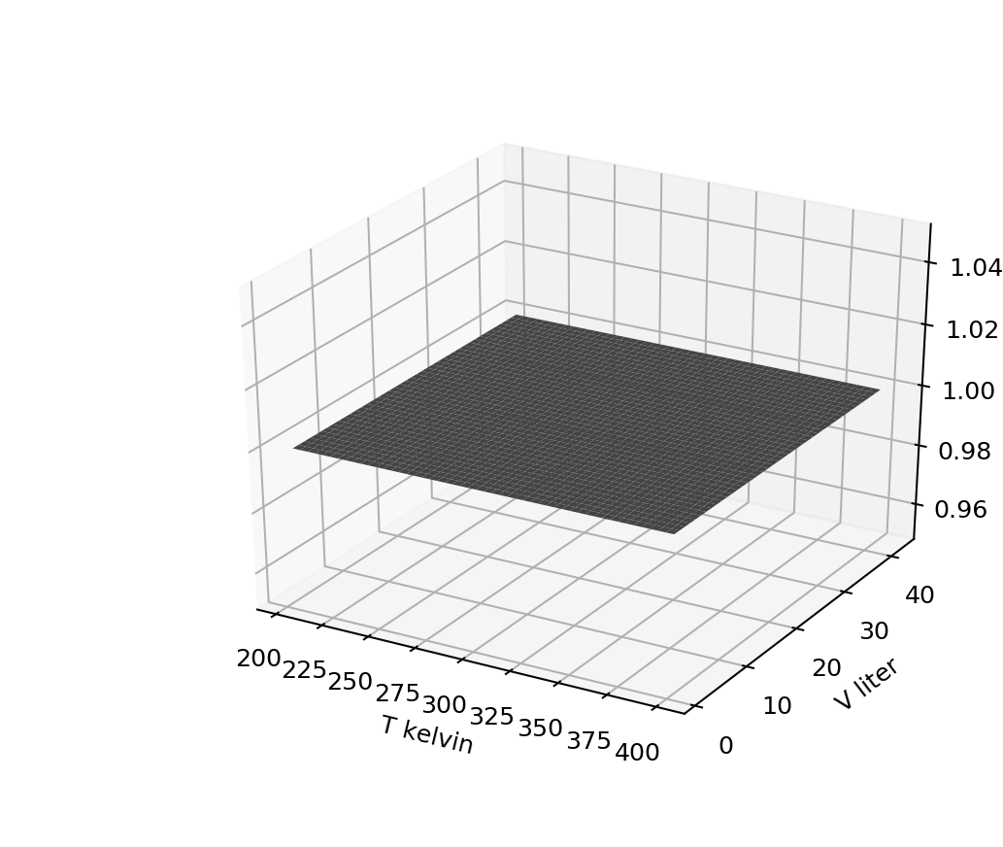
Week 2
No-brainers
Which surface could we be looking at now?
1. ${\left(\frac{∂P}{∂V}\right)}_{T}$
$2. {\left(\frac{∂P}{∂T}\right)}_{V}$
${3. \left(\frac{∂T}{∂V}\right)}_{T}$
${4. \left(\frac{∂T}{∂T}\right)}_{V}$

Slide 10
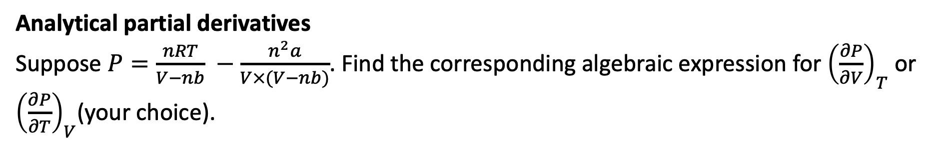
Week 2
Analytical partial derivatives
Suppose $P=\frac{nRT}{V−nb} −\frac{n^{2}a}{V×(V−nb)}$. Find the corresponding algebraic expression for ${\left(\frac{∂P}{∂V}\right)}_{T}$ or ${\left(\frac{∂P}{∂T}\right)}_{V}$(your choice).

Slide 11
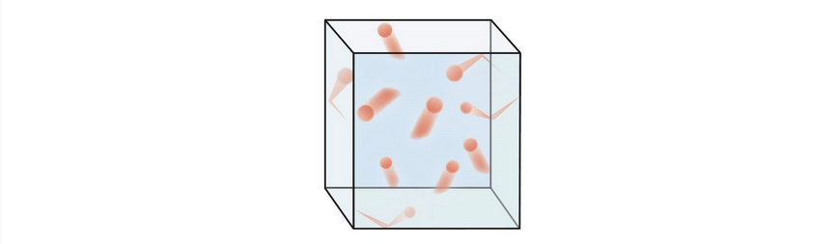
Week 3
The kinetic-molecular theory of gases
Describe a few key assumptions of the kinetic-molecular theory of gases and/or the theory behind the ideal gas law.

Slide 12
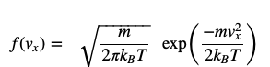
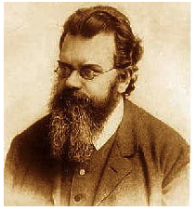
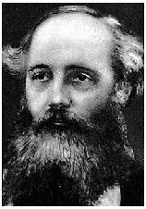

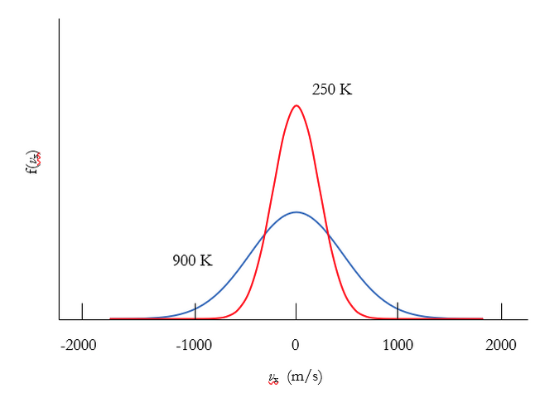

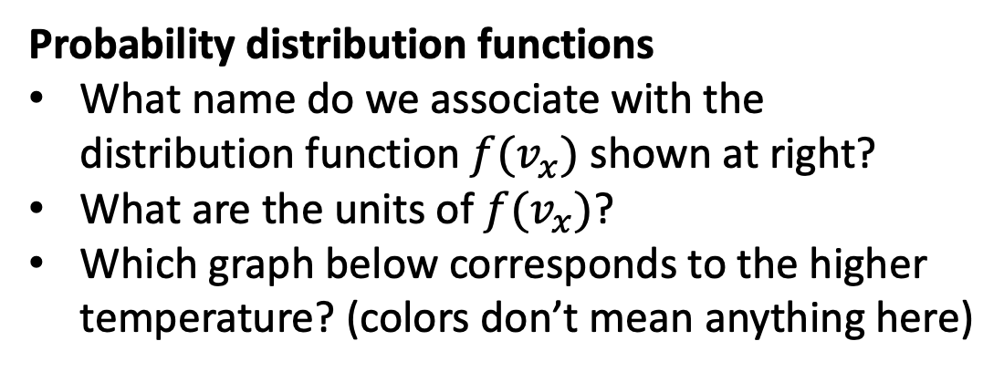
Week 3
Probability distribution functions
What name do we associate with the distribution function $f(v_{x})$ shown at right?
What are the units of $f(v_{x})$?
Which graph below corresponds to the higher temperature? (colors don’t mean anything here)
$$f(v_{x})$$

Slide 13
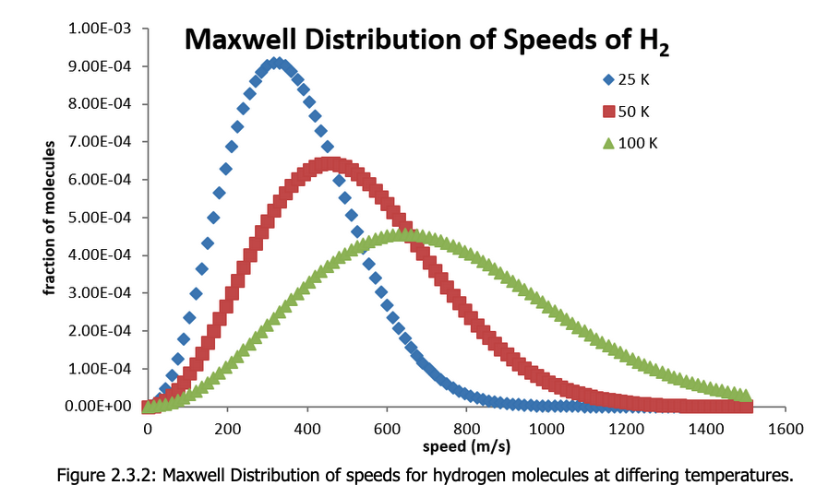

Week 3
Probabilities from distribution functions
What’s the probability (as a fraction, and also in %) of finding an H₂ molecule with speed between 390 m/s and 400 m/s, if its temperature is 100 K?
$f_{M}\left(v\right)$ $(\frac{s}{m})$

Slide 14
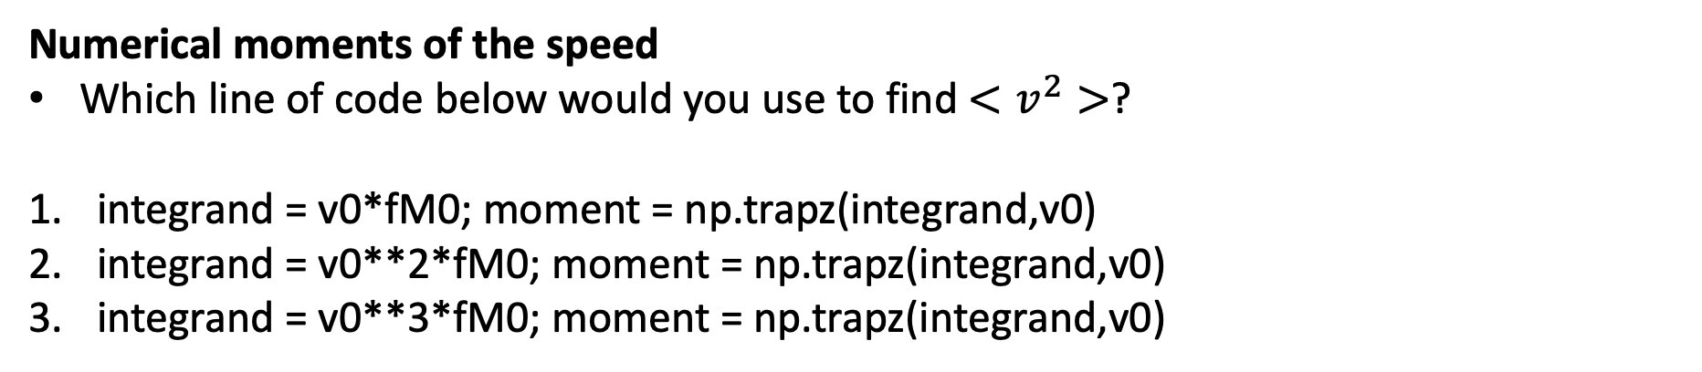

Week 3
$$f_{M}=N_{M}v^{2}\exp\left(−Dv^{2}\right)$$
Numerical moments of the speed
Which line of code below would you use to find $<v^{2}>$?
integrand = v0*fM0; moment = np.trapz(integrand,v0)
integrand = v0**2*fM0; moment = np.trapz(integrand,v0)
integrand = v0**3*fM0; moment = np.trapz(integrand,v0)

Slide 15
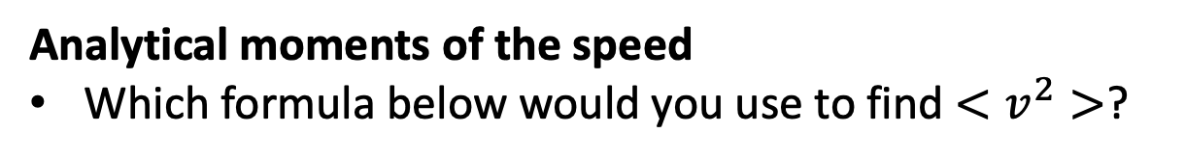
Week 3
$$f_{M}=N_{M}v^{2}\exp\left(−Dv^{2}\right)$$
Analytical moments of the speed
Which formula below would you use to find $<v^{2}>$?

Slide 16
Week 4
Equipartition theorem
Describe what the equipartition theorem is about, with an example

Slide 17
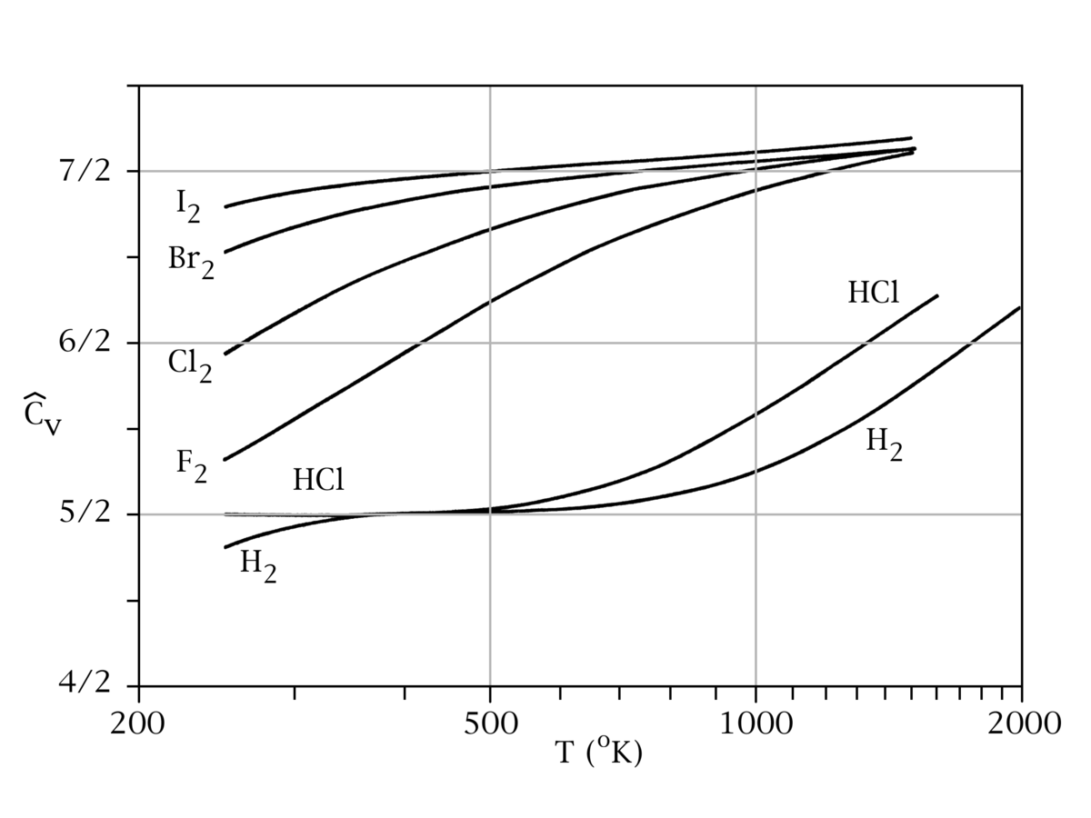
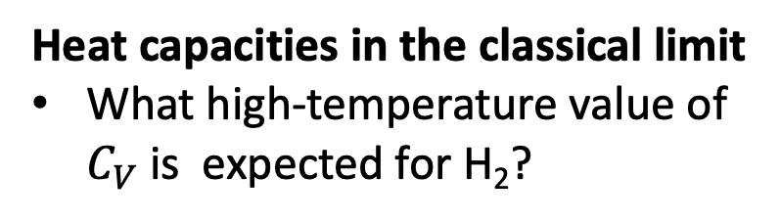

Week 4
Heat capacities in the classical limit
What high-temperature value of $C_{V}$is expected for H₂?
$$C_{V}$$

Slide 18
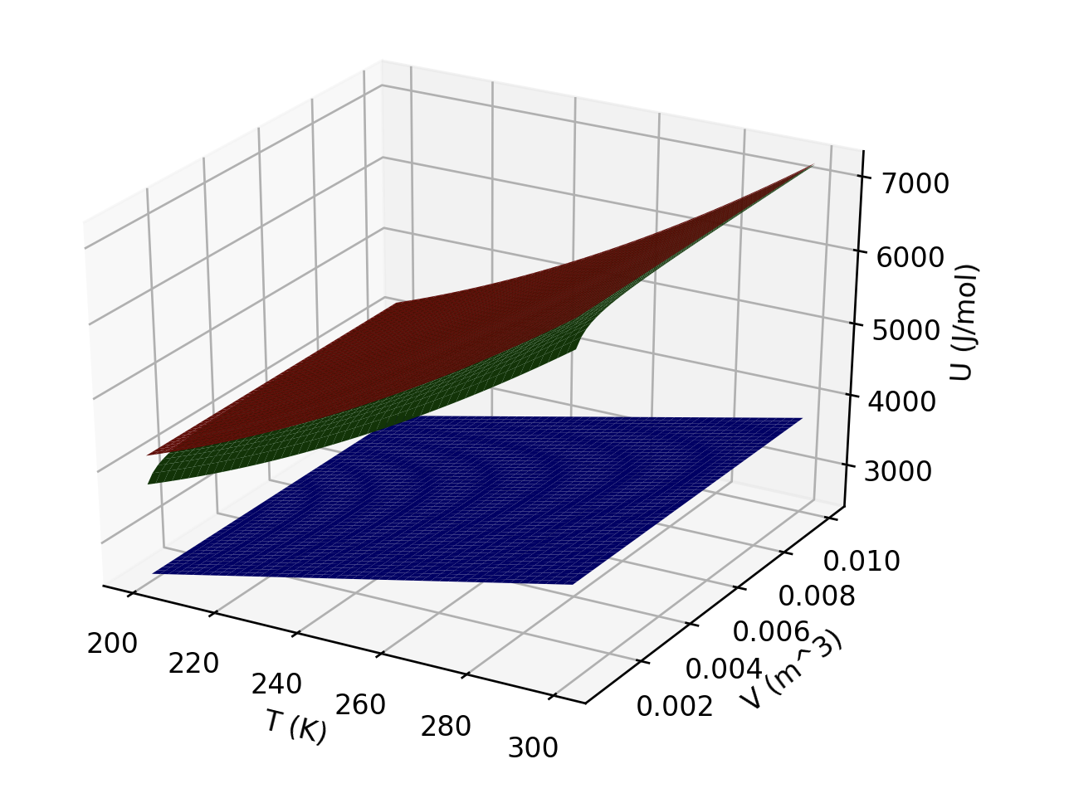
Week 4
Interpreting U(T,V)
What is responsible for the curvature (increasing slope with increasing temperature) of the red and green gases?
Which gas(es) could be ideal?
Which is probably a monatomic gas?

Slide 19
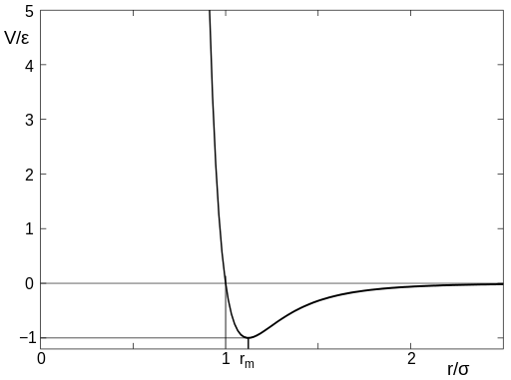
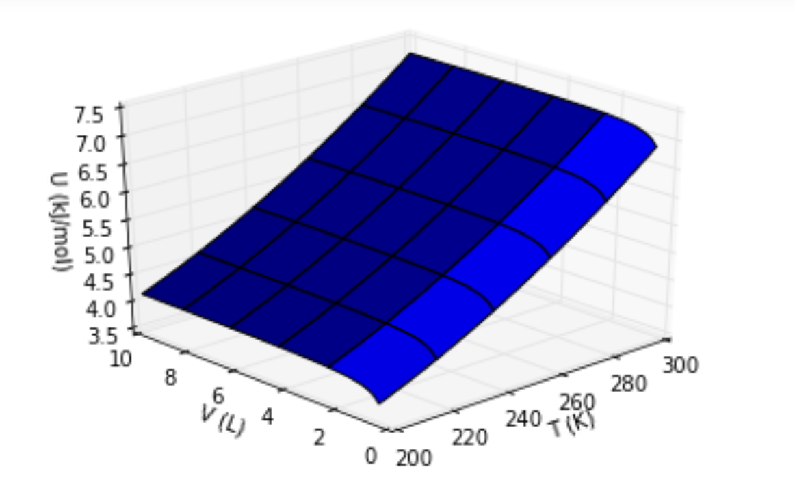

Week 4
Intermolecular potential energy
Describe the meaning of ‘d’ in the figure on the left
Describe what feature of the figure on the right is explained by the figure on the left
Intermolecular potential energy
d

Slide 20
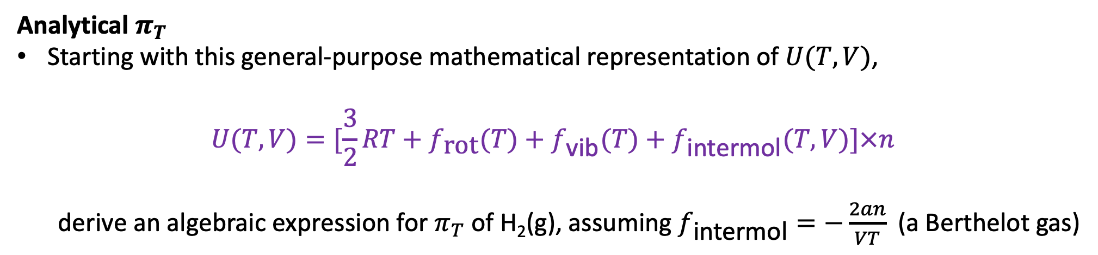
Week 4
Analytical $π_{T}$
Starting with this general-purpose mathematical representation of $U(T,V)$,
$$U(T,V)=[\frac{3}{2}RT+f_{\text{rot}}(T)+f_{\text{vib}}(T)+f_{\text{intermol}}(T,V)]×n$$
derive an algebraic expression for $π_{T}$ of H₂(g), assuming $f_{\text{intermol}}=−\frac{2an}{VT}$ (a Berthelot gas)

